Slide 1
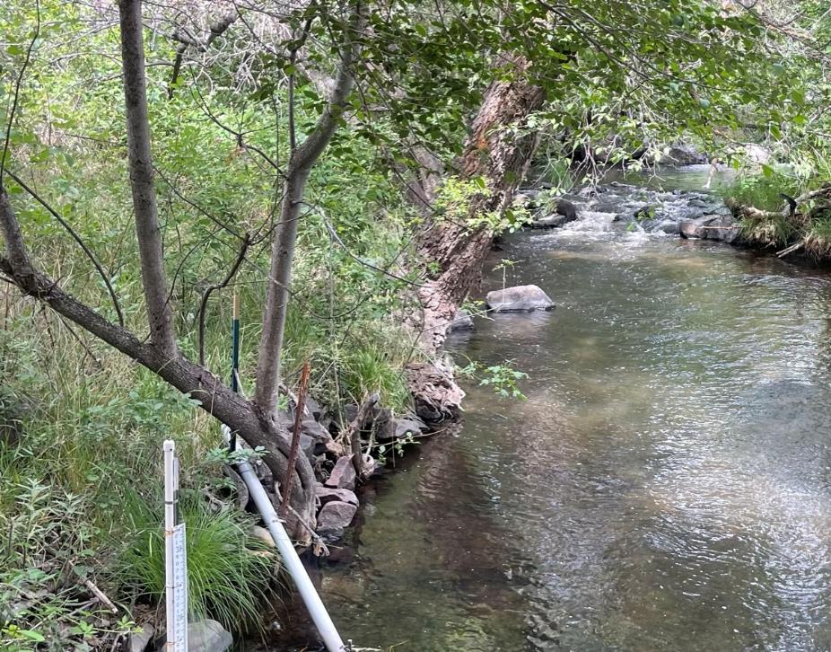
Klamath Basin Collaborative Monitoring Plan Workshop for a post-dam era
May 14 -15, 2025
Ashland Springs Hotel
Ashland Oregon
Bogus Creek, CA (Leonard 2025)
Notes:
BRUCE
Bogus Creek, CA (Leonard 2025)

Slide 2
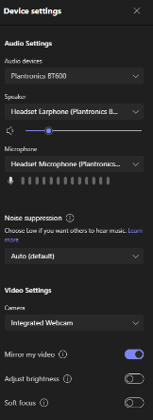
Virtual participants: Please leave web cameras on to facilitate discussion Please use the chat to introduce yourself (name and affiliation) In-person participants: Please sign in on sheet Please grab a name tag
Use the meeting chat if you need assistance.
Chats can be seen by all participants.
Please mute yourself when not speaking.
Use *6 to mute phone audio.
Use the microphone icon on the control bar to mute computer audio.
If you are having problems with audio/video, check your device settings.
Notes:
BRUCE
Betsy :
Restrooms etc
Map UP- ask for input!
Owl is sound sensitive,
Recording for note taking purposes.
Powerpoint slides available after meeting,
Virtual participation encouragement, MAP virtual option (link in CHAT), Use CHAT for input or RAISE HAND to speak
Show of hands for dinner adjust reservation
Lunches will arrive by noon
Microsoft Teams meeting for Day 1 and Day 2
Join on your computer, mobile app or room device
Click here to join the meeting
Meeting ID: 244 372 893 378 Passcode: SN2K5a
Download Teams | Join on the web
Or call in (audio only)
+1 207-387-0436,,843358102# United States, Portland
Phone Conference ID: 843 358 102#

Slide 3
Welcome, Introductory Remarks and Agenda
Notes:
BRUCE

Slide 4
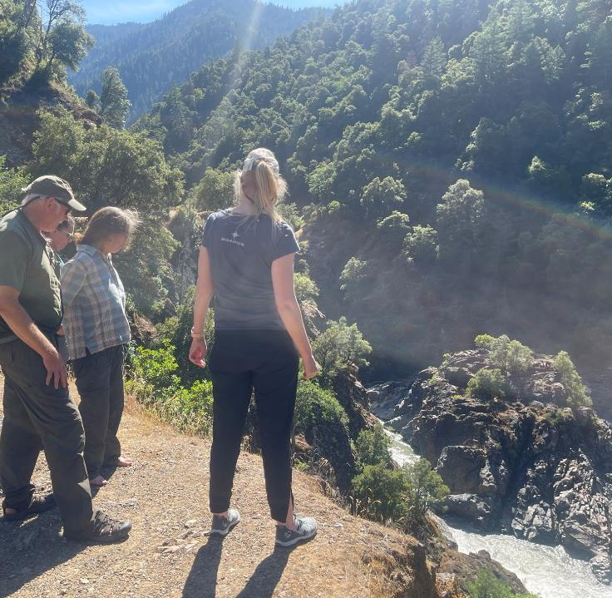
Why We are Here
Main Objective: Develop a strategy for conducting essential fisheries restoration monitoring with increased efficiency and cost-effectiveness.
Timeline & Opportunity: A draft strategy is targeted for completion by October 2025, supported through a series of meetings, workshops, and webinars. FWS may receive a final round of BIL funding this fall, with the potential to use a portion of those funds to support critical monitoring needs
Salmon River , CA (Leonard 2025)
Salmon River , CA (Leonard 2025)
Notes:
ADAM

Slide 5
Why Now?
Context:
IFRMP stakeholder-driven process (2017-2023) paved the way by identifying key restoration and monitoring goals in anticipation of dam removal.
Federal dollars form BIL and IRA have tackled some high priority restoration and monitoring needs but a lot more work needs to be done.
Federal agencies expect significant restructuring, hiring constraints, and budget reductions. This will impact states, Tribes and conservation partners (ag, fish, wildlife, wetlands, water, habitat)
Photo by USGS
Notes:
ADAM

Slide 6
Why Now?
Federal Presence – More Limited Moving Forward:
The U.S. Fish and Wildlife Service, in partnership with the Pacific States Marine Fisheries Commission, is funding this effort to provide a forum for stakeholder engagement—supporting both the development and implementation of the strategy.
Federal agencies remain committed to their missions in the Klamath Basin and to tribal trust responsibilities, but participation will depend on available resources, with staffing and funding expected to decline.
Call to Action: States, Tribes, and conservation partners must take a leading role in shaping and sustaining the monitoring strategy for the long term.
Lower Klamath National Wildlife Refuge in CA. Credit: USFWS
Notes:
ADAM
Lower Klamath National Wildlife Refuge in CA and winter waterfowl. Credit: USFWS
https://www.flickr.com/photos/usfws_pacificsw/52304145328/in/album-72177720301505972

Slide 7
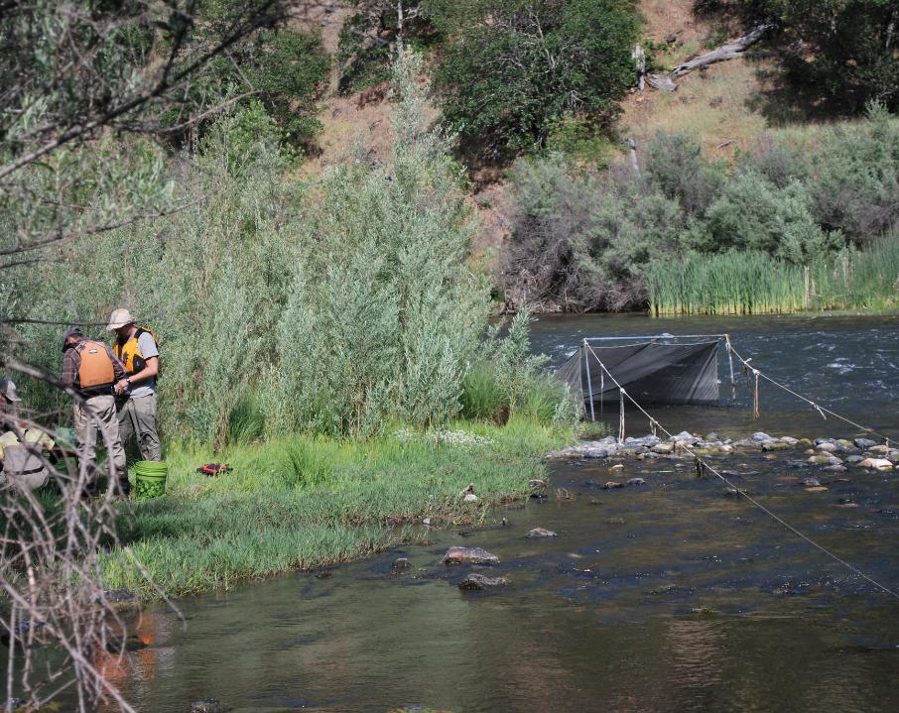
Planning Committee
Mike Belchik, Yurok Tribe
Jordan Ortega, Klamath Tribes
Benji Ramirez, ODFW
Crystal Robinson, CDFW
Nell Scott, Trout Unlimited
Toz Soto/ Alex Corum Karuk Tribe
Betsy Stapleton, Scott River Watershed Council
Klamath River Mainstem, Oregon (USFWS 2015)
Notes:
BRUCE
Klamath River Mainstem, Oregon (USFWS 2015)

Slide 8
Timeline Process, Outcomes and Products
Initiation
Jan-Apr 2025
1st Workshop
May 14-15, 2025
Tech SC Tasks
May 15 – June 20
2nd Workshop
June 24-25, 2025
Convene planning committee
Identify presenters for needed topics
Initiate gap discussion and prioritization
Approach for 5-yr monitoring strategy
Form Technical Steering Committee
List shared management and research questions
Criteria to prioritize/sequence for next 5 yrs funding scenarios
Refine shared list questions
Refine criteria
Confirm approach to develop 2026-2027 list of priority monitoring
List of Priority Monitoring for 2026-2027 Funding
July-Sept 2025
Federal Fiscal Year Recommendations
Oct 1, 2025 (tentative)
Tech SC Tasks
Sept 2025 Oct 2026
Klamath Basin Collaborative 5yr Plan
Oct 2026
Provide content for strategy
Consider most informative timing for a Science Symposium
PSMFC assist with compilation and product development
Finalized list of Klamath Basin monitoring (existing/new) to prioritize for 2026-2027 funding
Submit agreed-to recommended prioritized monitoring list to funding agencies
Produce 5-yr Plan
Approach to continue this collaborative forum 2025-2030 to implement and revise 5-yr Plan
Notes:
BRUCE
Lost River and Tule Lake (USFWS 2011)

Slide 9
Logistics
Day 1: May 14; 9:00am – 3:45pm
Day 2: May 15; 9:00am – 12:00pm
Hybrid Meeting
Lunch (11:45 – 1:15)
Lost River and Tule Lake (USFWS 2011)
Notes:
BRUCE
Lost River and Tule Lake (USFWS 2011)

Slide 10
Agenda
Welcome and Introductory Remarks | 9:00 – 9:30
Existing Monitoring Activity - Collaboratives, Upper Basin, Upper and Mid River | 9:30 – 11:45
Lunch | 11:45 – 1:15
Existing Monitoring Activity - Lower River, Trinity and South Trinity Rivers Group Discussion | 1:15 – 2:00 2:00 – 3:30
Plans for Day 2 | 3:30 – 3:45
Notes:
BRUCE

Slide 11
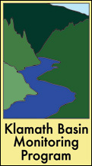
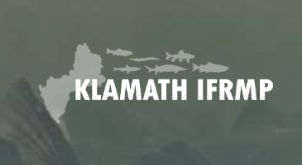
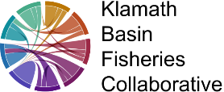
Existing Inventories
Existing Fish Monitoring Activity
Notes:
MATT

Slide 12
Integrated Fisheries Restoration and Monitoring Plan: Monitoring
Notes:
MATT

Slide 13
Today's Meetings has IFRMP Roots
Key Stakeholder Recommendations from IFRMP Process
During the IFRMP process, stakeholders identified several priority actions to strengthen monitoring and adaptive management:
Convene regular "science and adaptive management" symposia
Establish a "monitoring coordination group" to:
Recommend approaches for allocating monitoring resources
Prioritize monitoring objectives
Coordinate data aggregation and reporting
Develop strategies for applying monitoring results in adaptive decision-making
Notes:
MATT

Slide 14
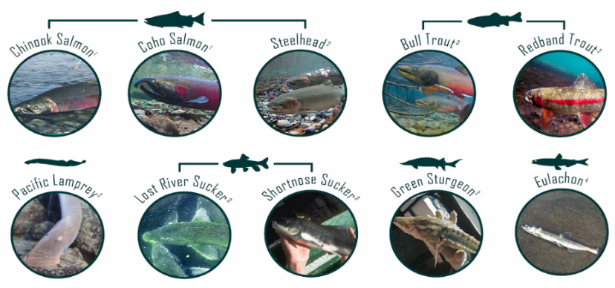
IFRMP’s Central Question?
What habitat restoration actions will provide the broadest possible benefits to achieve basin-wide recovery for 10 native Klamath Basin fish species – and how do we iteratively update priorities through time?
Notes:
MATT
Central question… {read}
Earlier phases of IFRMP development worked to assemble and review conceptual models to reflect the best available information regarding fluvial geomorphic, habitat and biological processes and linkages throughout the Klamath Basin
The IFRMP is the only plan that provides a CONSISTENT framework from which to prioritize, sequence and choose restoration projects and monitor results at the basin wide scale.
The framework emphasizes finding restoration projects that are likely to provide the broadest multi-species benefits not just benefits for individual target species.
Priorities at any given time are also always going to be a snapshot in time. So the framework and tools developed need to be readily updateable through time.
These key stressors have significantly impaired underlying watershed functional processes, eroded water quality, and contributed to dramatic declines in the populations of many native fishes (Figure 1‑2), including spring- and fall-run Chinook Salmon (Oncorhynchus tshawytscha), Coho Salmon (O. kisutch), and steelhead trout (O. mykiss), as well Pacific Lamprey (Entosphenus tridentata), eulachon (Thaleicthys pacificus), Green Sturgeon (Acipenser medirostris), Bull Trout (Salvelinus confluentus), Redband Trout (O. mykiss newberrii), and the endangered shortnose sucker (Deltistes luxatus) and Lost River sucker (Chasmistes brevirostris) (Hamilton et al. 2005; NRC 2008; Stanford et al. 2011; USDI et al. 2012; USDI, USDC, NMFS 2013; ESSA 2017).

Slide 15
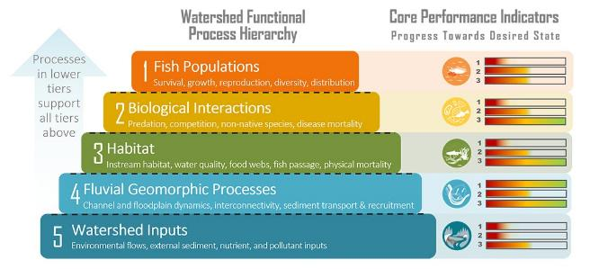
Focus on Process-based Monitoring via CPIs
“You can’t manage what you don’t measure”
Core Performance Indicators (CPIs): Critical, informative indicators to keep monitoring regularly, even when resources are limited, to reliably track overall system status.
Provide a common yardstick to measure progress.
CPIs selected by participants within each watershed functional tier.
Notes:
MATT
Objectives for each major biophysical tier are linked to Core Performance Indicators that will subsequently be monitored to track and communicate progress on achieving these objectives and their overarching goals.
CPIs can be thought of as the ‘vital signs’ of a watershed, those fundamental measures that can provide an overall snapshot of river basin health in the same way that heart rate, blood pressure, and body temperature provide an overall snapshot of human health.
Because data is not currently available for all of these CPIs across the Klamath Basin, we worked with Sub-basin Working Group members to select from among a candidate set of currently available basin-wide proxy data sets for use as CPI proxies in Phase 3 for purposes of informing one of our prioritization scoring criteria.

Slide 16
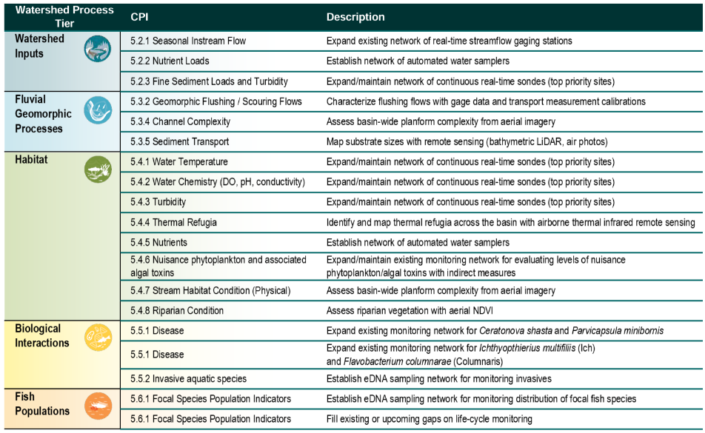
Tier 1 Monitoring Activities
Most important for near-term implementation
Most comprehensive understanding of basin-wide status and trends
Notes:
MATT

Slide 17
Fish Populations - Focal Species Population Indicators
Recommended Monitoring Actions & Costs
Recommendations
Establish eDNA sampling network for monitoring distribution of focal species
Support current initiatives in the basin focused on integrating and sharing information related to fish population indicators
Support ongoing fish population monitoring efforts throughout the basin
Existing Monitoring
Well established monitoring across basin by numerous entities
Population info includes spatial & temporal distribution, presence of spawning and rearing
Gaps/Needs
Ensure monitoring infrastructure can effectively track changes
Sharing data across monitoring agencies to allow for full integration of information at the basin-wide scale
Better understanding of Chinook fishery management, e.g., age-structure escapement estimate by subbasin
Establish a life-cycle monitoring site in the lower Klamath River mainstem
Recommendation | 1-Year Cost | 10-Year Cost
Establish eDNA network for focal species | $275,00 | N/A
Support initiatives on fish population information sharing (PIT Tag Detection) | $8,589,000 | $51,024,000
Support ongoing fish population monitoring efforts | $14,094,000 | $180,426,000
Fill existing or upcoming gaps on life-cycle monitoring | Workshop (TBD) | Workshop (TBD)
Notes:
MATT

Slide 18
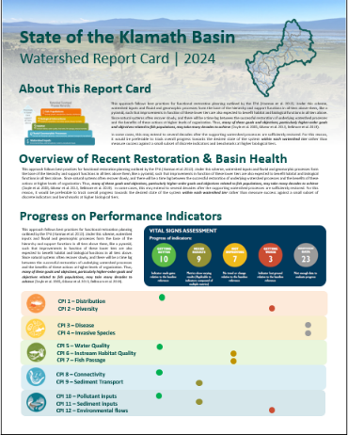
Reporting Progress on IFRMP Goals & Objectives Proposed “State of the Klamath Basin” report
Potential content:
Trajectory of performance indicators (static, getting better, getting worse)
Number / types of restoration projects funded this cycle
Number / types of restoration projects funded to date
Restoration project spotlights / case studies
Emerging issues / restoration needs
Emerging science
Notes:
MATT

Slide 19
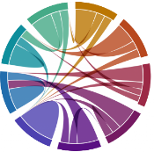
Klamath Basin Fisheries Collaborative
Notes:
BRUCE introduce JIMMY

Slide 20
Bringing it all Together
Data Integration for Fisheries Research and Management Success
Klamath Basin Fisheries Collaborative
Notes:
USGS requires that the USGS logo be placed in the upper left of the title slide and lower left of every slide there after. I suggest that SRWC also place a logo on each slide with the USGS logos. This is collaborative after all.

Slide 21
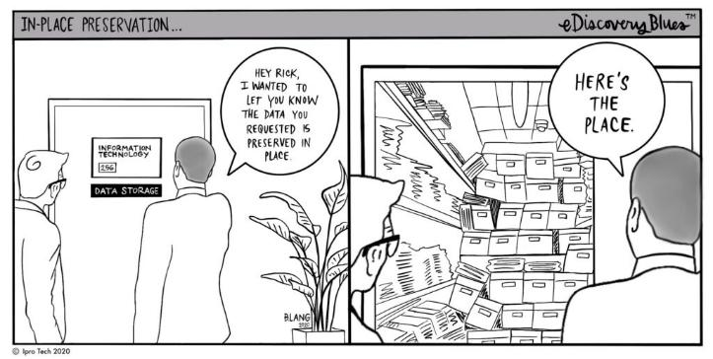
Standardized Data System
Data are preserved and accessible to inform work within an organization and externally
Data are correctly understood by others
Facilitates individual data systems exchanging with collaborative data system

Slide 22
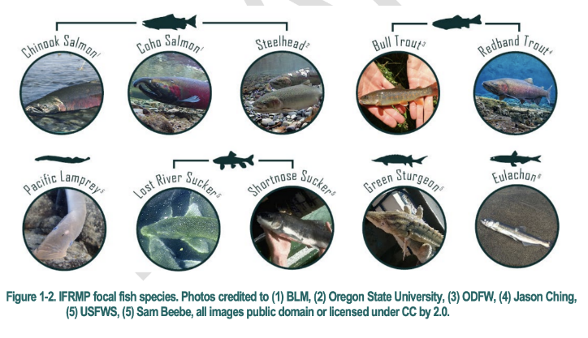
KBFC Purpose
Facilitate access to fisheries PIT tag data and associated metadata
Build a network of collaborators
Advance research to inform fisheries management and restoration actions

Slide 23
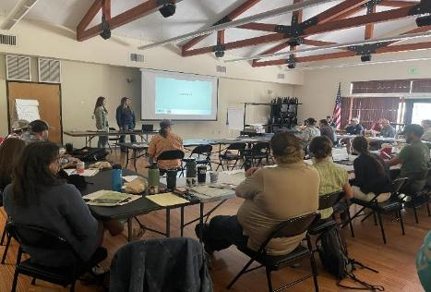
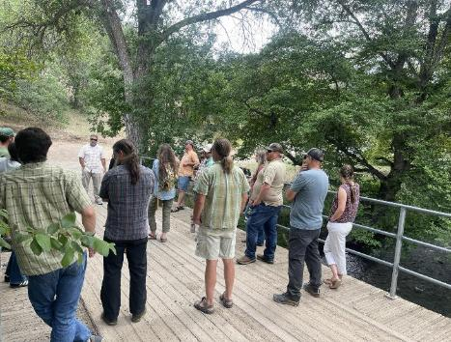
What We Are:
A data integration and management project
A collaborative of over 30 fisheries tag data producers and users in the Klamath Basin
A venue to share monitoring data, ideas, technical expertise and opportunities
Leadership Team
Klamath Tribes
Karuk Tribe
Yurok Tribe
Hoopa Tribe
USGS
ODFW
CDFW
Scott River Watershed Council
PSMFC- Support

Slide 24
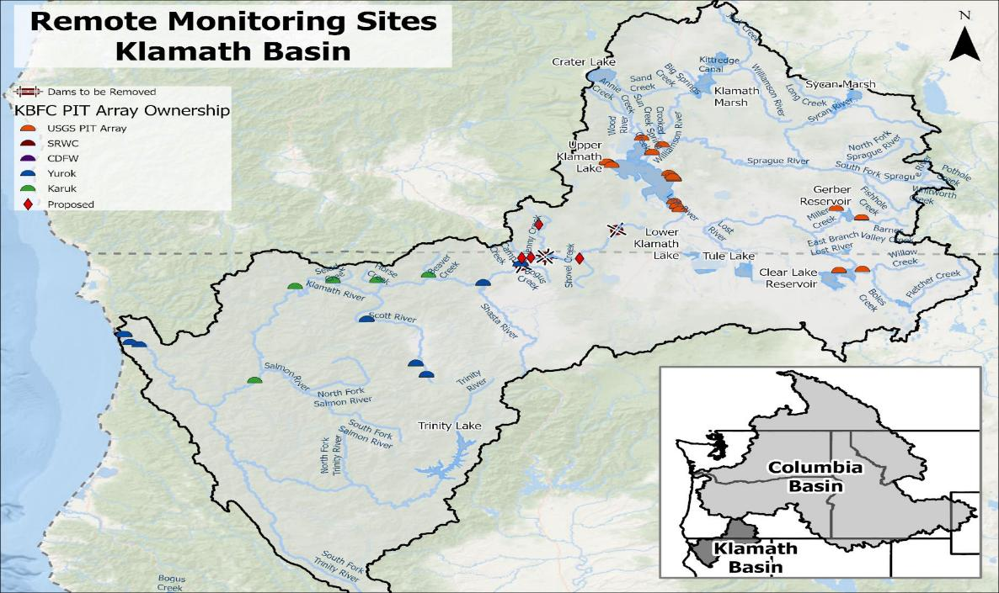
Notes:
Discussions and development started in 2009 followed by a lapse in funding and interest. As a group we knew we needed a collaborative database.

Slide 25
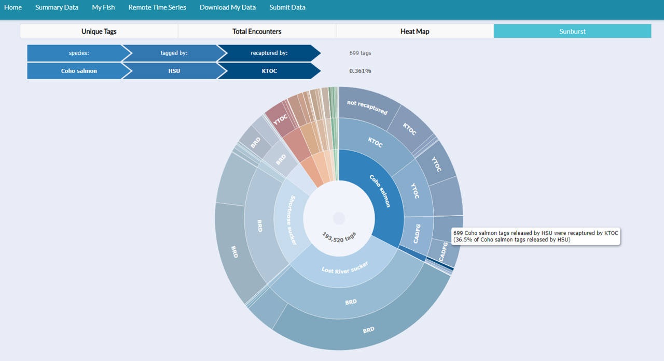

Slide 26
Collaborative Products
Lestelle, L. C. 2007. Coho Salmon (Oncorhynchus kisutch) Life History Patterns in the Pacific Northwest and California. Biostream Environmental, Poulsbo, WA.
Soto, T., A. Corum, H. Voight, D. Hillemeir, and L. Lestelle. 2008. The role of the Klamath River mainstem corridor in the life history and performance of juvenile coho salmon (Oncorhynchus kisutch). Phase 1 Report 2006-07 Winter. Prepared for Bureau of Reclamation Mid-Pacific Region, Klamath area Office, Klamath Falls, OR.
Hillemeier, D., T. Soto, S. Silloway, A. Corum, M. Kleeman, and L. Lestelle. 2009. The role of the Klamath River mainstem corridor in the life history and performance of juvenile coho salmon (Oncorhynchus kisutch) - May 2007 – May 2008. Report submitted to the U.S. Bureau of Reclamation, Klamath Area Office, Klamath Falls, Oregon.
Soto, T., D. Hillemeier, S. Silloway, A. Corum, A. Antonetti, M. Kleeman, and L. Lestelle. 2016. The Role of the Klamath River Mainstem Corridor in Life History and Performance of Juvenile Coho Salmon (Oncorhynchus kisutch), Period Covered: May 2007−August 2011. Report submitted to the U.S. Bureau of Reclamation, Klamath Falls, OR.
Faukner, J., S. Silloway, M. Sparkman, and P. Drobny. 2017. A previously undocumented life history behavior in juvenile coho salmon (Oncorhynchus kisutch) from the Klamath River, California. California Fish and Game 103:72-78.
Manhard, C.V., N.A. Som, R.W. Perry, J.R. Faukner, and T.L. Soto. 2018. Estimating freshwater productivity, overwinter survival, and migration patterns of Klamath River Coho Salmon. U.S. Fish and Widlife Service. Arcata Fish and Wildlife Office, Arcata Fisheries Technical Report Number TR 2018-33, Arcata, California.
Faukner, J., S. Silloway, A. Antonetti, T. Soto, A. Corum, E. Tripp, and L. Lestelle. 2019. The role of the Klamath River mainstem corridor in life history and performance of juvenile coho salmon (Oncorhynchus kisutch). Period Covered: September 2011-June 2017. Report submitted to the U.S. Bureau of Reclamation, Klamath Falls, OR.
Dodrill, M.J., R.W Perry, N.A. Som, C.V. Manhard, and J.D. Alexander. 2022. Extending the Stream Salmonid Simulator to Accommodate the Life History of Coho Salmon (Oncorhynchus kisutch) in the Klamath River Basin, Northern California. U.S. Geological Survey Open-File Report 2022-1071, 70p.
Munsch, S.H., T.R. Bennett, J. Faukner, M.J. Halloran, K.M. Halloran, K.M. Hanson, M.C. Liermann, M.L. McHenry, J.R. McMillan, R.E. Moses, B. Pagliuco, G.R. Pess, K.R. Stonecypher, and D.M. Ward. 2025. Juvenile salmoinds traverse coastal meta-nurseries that connect rivers via the sea. Frontiers In Ecology and the Environment (https://doi.org/10.1002/fee.2848).

Slide 27
What’s Next?
Grow Relationships- new partners, support growth of others, avoid duplication and competition
Continued refinement of database and upload of data
Electronic Data Collection
New Monitoring Locations- Dam Removal Reach, Mainstem Arrays, RSTs
More focus on other species – Chinook, O. mykiss
New Technology and New Techniques
Secure ongoing funding and resources for sustained collaboration and data sharing

Slide 28
Klamath Basin
Monitoring Program
Notes:
BRUCE introduces Randy?

Slide 29
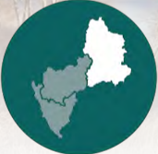
Upper Klamath Basin
Existing Fish Monitoring Activity
Notes:
Bruce introduces Jacob/Ben

Slide 30
Upper Klamath Basin
Jacob Krause
Notes:
Bruce introduces Jacob/Ben

Slide 31
Overview of sucker monitoring in the Upper Klamath Basin
Jacob Krause, Research Fish Biologist, USGS Western Fisheries Research Center
This information is preliminary and is subject to revision. It is being provided to meet the need for timely best science. The information is provided on the condition that neither the U.S. Geological Survey nor the U.S. Government shall be held liable for any damages resulting from the authorized or unauthorized use of the information.

Slide 32
Upper Klamath Basin
Ben Ramirez
Notes:
Bruce introduces Jacob/Ben

Slide 33
Klamath basin collaborative monitoring plan
Upper Klamath basin monitoring

Slide 35
Water
OSU – fish disease monitoring – parasites and pathogens
Water sampling – monthly (march through oct) – Wood river, Williamson river, klamath river
Determine parasite density in water samples
Sentinel fish exposures – wood river, Williamson river, klamath river
Edna – klamath mainstem below link dam, spencer creek, upper klamath lake, Williamson, wood, and Sprague rivers
Usgs – water quality monitoring
Klamath river, upper klamath lake

Slide 36
Water
The Klamath tribes
Baseline conditions and long-term trends in the upper klamath basin
A large suite of parameters are included in sampling that occurs every two weeks from May through October
Nutrient loading monitoring throughout the year in upper klamath lake, wood, Williamson, and Sprague watersheds
Upper klamath lake, wood river (and tribs), Williamson river, and Sprague river

Slide 37
Fish monitoring
Odfw – anadromous fish monitoring
Adult spawning surveys – klamath river, spencer creek
In the future – keno dam, link river dam, tributaries to upper klamath lake
In the future – radio tracking of adult salmon and steelhead
Juvenile fish monitoring in spencer creek
Odfw – adfluvial redband trout monitoring
Williamson, Wood, crystal creek, other tribs – spring dominated habitats
Odfw, usfws, crater lake np, usfs
Bull trout – sun creek, threemile creek, wood river and tribs, sycan and Sprague subbasins

Slide 38
Fish monitoring
The Klamath tribes – anadromous spawning surveys in tribs to upper klamath lake
Eventual radio tracking of adult salmon and steelhead
The klamath tribes – downstream migrant trap (RST) in the Sprague river
Bor – adult sucker monitoring – upper klamath lake and tribs, clear lake and tribs, gerber reservoir and tribs
Juvenile sucker monitoring in upper klamath and clear lakes
Pit array monitoring throughout the upper basin
Link river fish ladder
Juvenile and adult sucker telemetry

Slide 39
Fish monitoring
Bor – upper klamath lake
parasites and disease
Entrainment and salvage in klamath project network
Avian bird predation

Slide 40
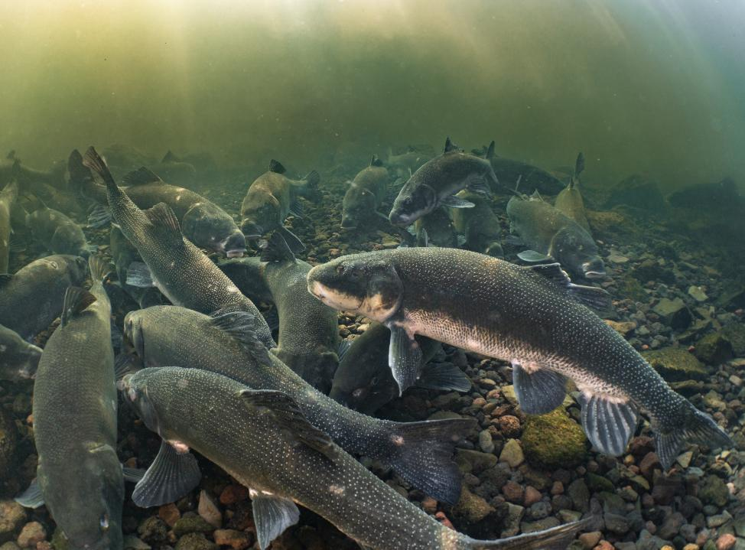
Back in 15 minutes
Break
Over 16 suckers gather on the graveled river bottom. Photo courtesy of Jason Ching/University of Washington (USFWS).
Notes:
Bruce
Over 16 suckers gather on the graveled river bottom. Photo courtesy of Jason Ching/University of Washington (USFWS).

Slide 41
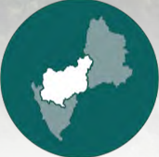
Mid-Upper Klamath Basin
Existing Fish Monitoring Activity
Notes:
Bruce introduces
IFRMP Plan maps and icon

Slide 42
Mid-Upper Klamath Basin
Toz Soto
Notes:
Bruce introduces
IFRMP Plan maps and icon

Slide 43
Klamath basin collaborative monitoring plan
Middle Klamath River

Slide 44
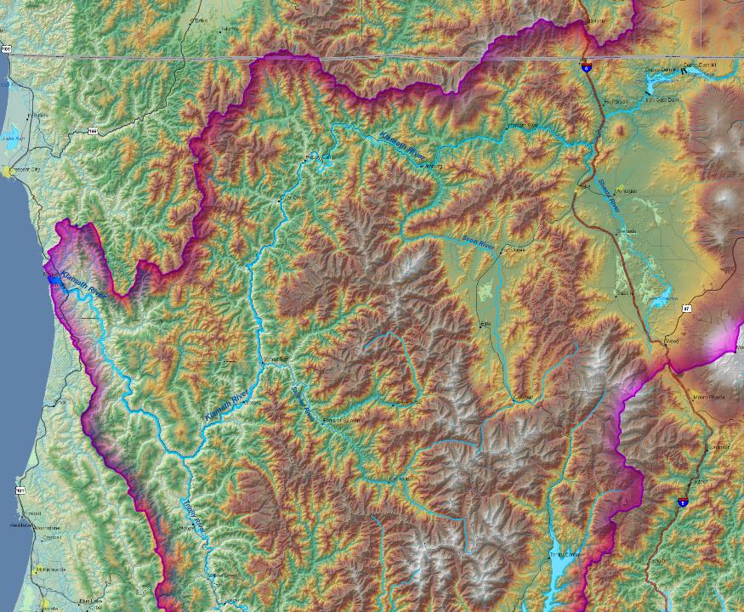
Middle Klamath R
Shasta R subbasin
Scott R subbasin
Salmon R subbasin
Trinity R subbasin

Slide 45
Water Quality
Flow/Discharge-Orleans, Seiad Valley and Iron Gate-USGS
Realtime Water Quality w/ DataSondes-Orleans, Seiad Valley, Walker Bridge, Shasta, Iron Gate-Karuk, USGS, RES
Water Quality- Grab Samples-Karuk, RES
Water Temperature -Data Loggers-Tributaries- Karuk, MKWC

Slide 46
Fish Monitoring
Fall Run Chinook Spawning Tributaries – Karuk, MKWC, CDFW, Klamath NF, Six Rivers NF
Fall Run Chinook Spawning Mainstem- Stateline to Happy Camp-Arcata USFWS Office, Karuk, Yurok, RES
Coho Spawning Tributaries- Karuk, MKWC
Coho Spawning Mainstem-Karuk, Arcata FWS
Summer Steelhead Spring Chinook Snorkel Counts- Klamath NF, Six Rivers NF, Karuk, MKWC
Mainstem SONAR/Tangle Netting at Iron Gate- CalTrout, Karuk, Yurok, CDFW, Keith Denton
Mainstem Radio Telemetry above Iron Gate-Karuk, CalTrout, CADFW,ODFW

Slide 47
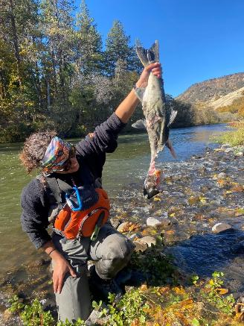
Mainstem Klamath Spawning Surveys
Carcass Mark and Recapture
Redd Counts
Live Counts
Tissue, Scale, Otolith, Gut/Stomach/Kidney

Slide 48
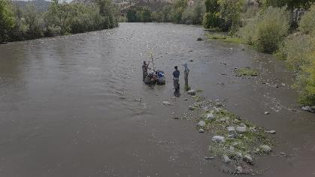
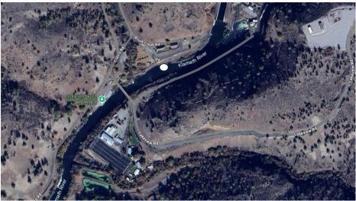
Monitoring with SONAR
ARIS 1800 multi-beam SONAR in the mainstem Klamath River approximately 200 meters below the former Iron Gate dam
The SONAR records movie-like imagery of a cone shaped cross section of the river and thereby any fish migrating up or downstream

Slide 50
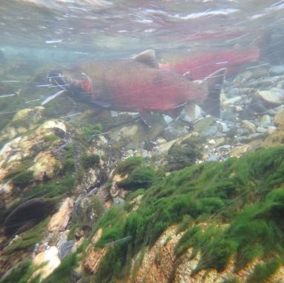
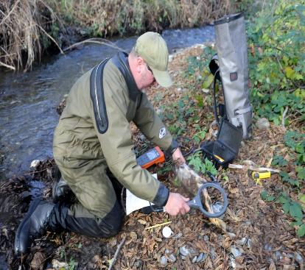
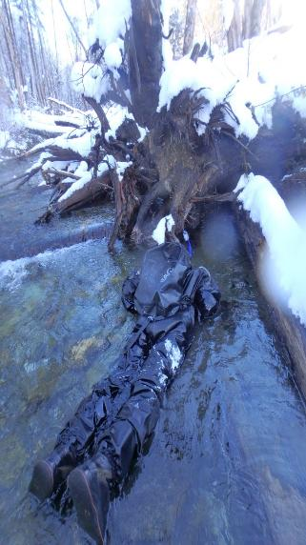
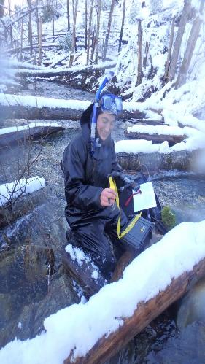
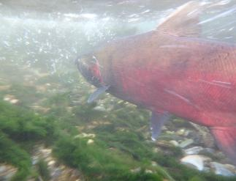
Coho Spawning Surveys-Middle Klamath Tributaries

Slide 51
Fish Monitoring
Juvenile Outmigrant Monitoring Mainstem Klamath
Mainstem above Trinity – Weitchpec Trap-Yurok, Big Bar Trap-Karuk
Mainstem above Scott-Kinsman Traps-Karuk/USFWS
Mainstem above Shasta-I5 Traps and Bogus Creek Trap-USFWS
Fish Health Monitoring/Juvenile Salmonid
C-Shasta Spore Concentrations-Water Samples-Karuk, OSU Lab
C-Shasta Infection Prevalence in Juvenile Chinook- Fish Samples-Karuk, USFWS
C-Shasta Annelid Host Monitoring- OSU

Slide 52
Fish Monitoring
Habitat and Restoration Project Monitoring
Off-Channel Pond-Juvenile Coho Winter Rearing Population Estimates
Seiad Creek Ponds, Horse Creek Ponds, Beaver Creek Ponds, Red Cap Creek Ponds and other misc. pond sites
PIT Tagging and Remote Detection/Coho Life Cycle Monitoring-Seiad Creek, Horse Creek and Sandy Bar Creek
Food Web Studies- Pre and Post Dam Removal- Cal Poly Humboldt, UC Davis, Karuk, Yurok
Cold Water Thermal Refugia Utilization for S3 Model- USGS, Karuk, Yurok, SRWC

Slide 53
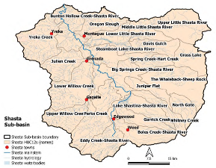
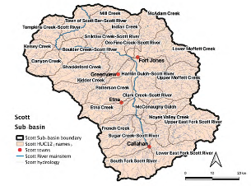
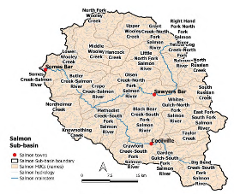
Shasta, Scott and Salmon Rivers
Notes:
IFRMP Plan maps and icon

Slide 54
Shasta, Scott and Salmon Rivers
Crystal Robinson
Notes:
IFRMP Plan maps and icon

Slide 55
Current Fisheries Monitoring Scott, Shasta, Bogus, Jenny, Fall & Shovel
California Department of Fish and Wildlife
Klamath Watershed Program
Crystal Robinson, KWP Supervisor
May 14th, 2025

Slide 56
Adult Salmonid Monitoring
Video Weirs – enumerating adult Fall Chinook and Coho Salmon
Who: CDFW
Where: Near Tributary Confluences w/Klamath
Why
Estimates of tributary returns
Harvest Management
Trend Monitoring
Inform Restoration
Funding - no new direction of a funding change currently
Sport Fish Restoration Act
Coastal Monitoring Program
Data Gaps & Monitoring Alternatives
Late season O.mykiss and Coho Salmon migration data – flow challenges
Alternatives exist but the passive weir is the least impactful

Slide 57
Adult Salmonid Monitoring
Spawning Ground Surveys – collection of spatial redd data and biological information from carcasses of adult Chinook and Coho Salmon
Who: CDFW, Klamath Nation Forest, Tribes, Resource Conservation Districts, Watershed Councils
Where: Based on Landowner Access
Why
Harvest Management
Spatial Trends
Informs Restoration and Water Management
Funding - no new direction of a funding change currently
Sport Fish Restoration Act
Coastal Monitoring Program
US Fish & Wildlife Service
Data Gaps & Monitoring Alternatives
More data from Scott, Shasta and Bogus
Aerial imagery for redd locations (?), no alternatives for biological samples

Slide 58
Adult Salmonid Monitoring
Scott River Summer Dive – enumeration and spatial distribution of adult salmonids in the Scott River Canyon at baseflow
Who: CDFW, Klamath Nation Forest, Tribes, Resource Conservation Districts, Scott River Watershed Council
Where: USGS Gaging Station to the Klamath Confluence
Why: Population Trends and Fish Periodicity - long term and real-time, informing:
identified flow targets
In-river water management
In-water work windows for restoration
Funding - no new direction of a funding change currently
CDFW – internal permanent staff, BCP and CMP for seasonals
Collaborators – voluntary
Data Gaps & Monitoring Alternatives
Shasta, Bogus, Jenny, Shovel
Juvenile dive work provides some of this information

Slide 59
Juvenile Salmonid Monitoring
Outmigration Traps – estimate abundance and timing of juvenile salmonids emigrating during the winter and spring
Who: CDFW
Where: near the Klamath confluences
Why: Population Trends and Fish Periodicity - long term and real-time, informing:
identified flow targets
In-river water management
In-water work windows for restoration
Funding - no new direction of a funding change currently
Coastal Monitoring Program
CA Budget Change Proposal
Data Gaps & Monitoring Alternatives
Expanding the monitoring windows as environmental conditions allow
No alternative to gathering the biological data

Slide 60
Juvenile Salmonid Monitoring
Snorkel Surveys – assessing juvenile habitat usage at baseflow
Who: Varies by Project
Where: selected reaches varies by watershed
Shasta – Canyon and Big Springs (CDFW & Karuk)
Scott - Canyon
Camp, Beaver & Deer – former reservoir rim to confluence
Jenny – ~1 mile upstream of the former reservoir rim
Fall – Fall Creek Hatchery to confluence
Shovel – current identified point of upper anadromy to confluence
Why: Population Trends and Fish periodicity: long term and real-time informing:
identified flow targets
In-river water management
In-water work windows for restoration
Funding
CDFW – internal permanent staff, BCP and CMP for seasonals
Karuk – grant funded currently, expires March 2026
Data Gaps & Monitoring Alternatives
More tributary coverage – access constraints
No alternative to gathering the spatial occupancy information

Slide 61
Juvenile Salmonid Monitoring
Juvenile Tagging Studies– multiple efforts tagging of juvenile salmonids for tracking throughout the basin
Who: USGS, Tribes, CDFW, Scott River Watershed Council
Where:
Shasta & Scott – USGS (Chinook), CDFW, SRWC
Bogus, Jenny (planned), Fall, Shovel – CDFW, SRWC
Why: Assessing the effect of managed flow and associated water temperature on outmigration survival of juvenile salmonids
Survival rates
Movement timing
Habitat and micro-habitat utilization
Funding
USGS – grant funded through this year
Karuk – grant funded currently
CDFW – internal permanent staff, BCP and CMP for seasonals
Data Gaps & Monitoring Alternatives
Detection arrays within large tributaries
Alternatives

Slide 62
Shasta, Scott and Salmon Rivers
Betsy Stapleton and Sarah Shaefer
Notes:
IFRMP Plan maps and icon

Slide 63
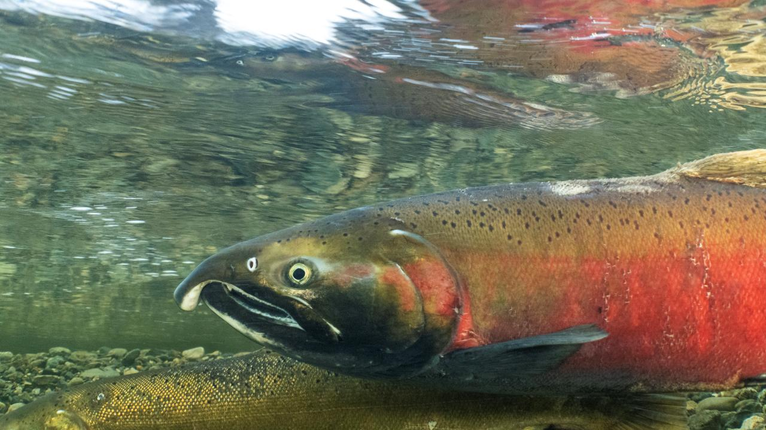
Scott Watershed Monitoring: Fish, Water & Physical Process
Sarah Schaefer, QVIR
Betsy Stapleton, SRWC

Slide 64
Fisheries: What Questions Are Being Addressed by Current Monitoring?
Status and trends of Scott fish populations
Chinook
Coho
(O. Mykiss) no to limited monitoring
(Lamprey) no to limited monitoring
How are fish using the habitat
What habitat restoration actions are effective and what are the limiting factors for fish (specifically coho)
What land/water management actions (and where) are necessary to support Scott fish populations.

Slide 65
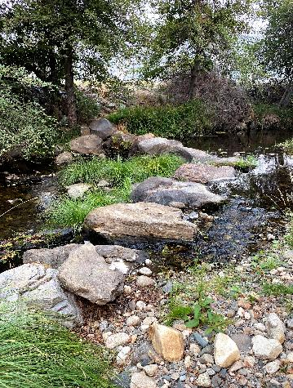
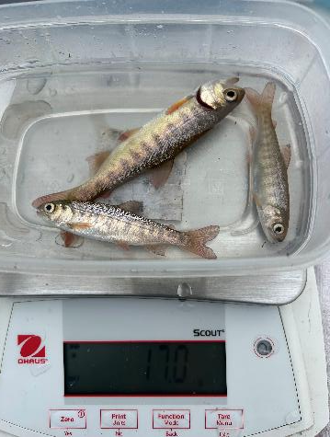
Regulatory Considerations
Listed coho
Fish and Game Code 5937

Slide 66
Fisheries: CDFW
Adult Spawning Weir
Rotary Screw Trap
Chinook carcass surveys

Slide 67
Fisheries: Scott River Watershed Council
Coho Spawning Surveys (with QVIR)
PIT Tagging
Juvenile Direct Observations
Eyes and Ears (with UC Davis)

Slide 68
Fisheries: QVIR
Coho and Chinnock Spawning Surveys (collaborative)
Juvenile Direct Observations

Slide 69
Fisheries: USFS, Water Trust, Amy Fingerle
Chinook and Coho Spawning Surveys (USFS, SRCD)
Project effectiveness monitoring (SRCD, Water trust)
Scott Chinook Genetics (Amy Fingerle)
Lamprey and Steelhead surveys (USFS-?)

Slide 70
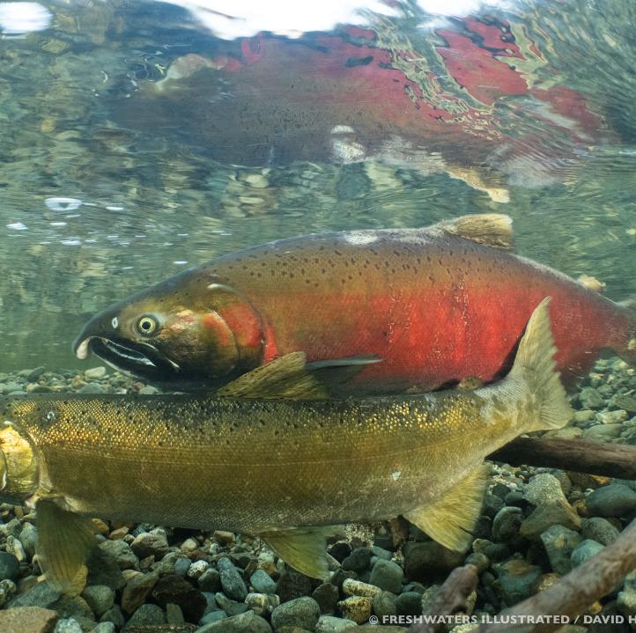
Fisheries: Data Gaps
Coordination of all efforts and planned integration with Basin info needs
O. mykiss
Lamprey
Full spatial Distribution
Pollutant effects on fish life cycle

Slide 71
Water: What Questions are Being Addressed by Current Monitoring?
Maintaining long period of record of total Scott discharge
GSP: groundwater and water quality management
Surface water management
Project specific effects
Connectivity and habitat quantity for fish
Climate change trends and water supply
Where are thermal refugia
Where do we have water quality impairments

Slide 72
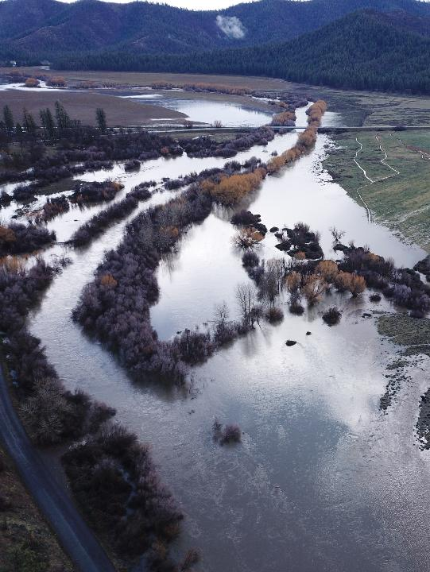
Regulatory Considerations
Scott River Degree: Surface Water (includes tributaries except French Creek)
French Creek Degree: Surface Water (Water Mastered)
Groundwater Sustainability Act Groundwater (medium priority basin)
Drought curtailments: 2021-2025
AB 263 (maybe)
Longterm flow standard (in process)
TMDL: Sediment, temperature and biostimulatory (portions)

Slide 73
Water: Flow
Who
QVIR (sites in KBMP spreadsheet)
SRWC (sites in KBMP spreadsheet)
CDFW
County (LWA)
Watermaster District
SRCD
Water Trust
Water Board
USGS Gages
CDEC Gages

Slide 74
Water: Quality
WHO:
QVIR (nutrients, temp, DO- Sites in KBMP spreadsheet))
SRWC (temp, DO- sites in KBMP spreadsheet)
SRCD
NCRWQCB
Forest service (?)

Slide 75
Water: Groundwater (WSE)
Who:
QVIR (sites in KBMP)
GSA (County/LWA)
SRWC (Sites in KBMP)
SRCD

Slide 76
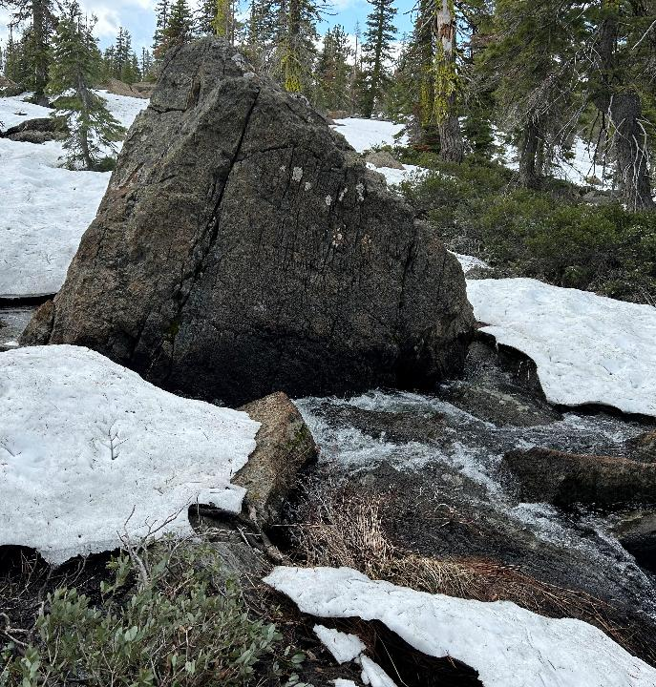
Other Water Related Monitoring
Snow surveys (USFS)
Groundwater models: UCD/Larry Walker (for County), DWR

Slide 77
Water: Data Gaps
Amount of groundwater extraction (actual not modeled)
Correlation of USGS flow to tributary connectivity (may be under study)
Mainstem Scott temps, especially pool stratification (assoc. w/ fish use)
Permanent real time stations on tribs and in mainstem (may be on the way to being solved)
How much flow is needed for recovery of fish at different locations for all life stages

Slide 78
Physical Processes and Other Parameters:
Questions:
What watershed processes improve or negatively impact conditions for fish?
Sediment
Geophysical conditions- incision vs floodplain connection
Ground and Surface Water
What food resources are available for fish?

Slide 79
Physical Processes
Who:
SRWC
Yurok
NCRP
State Waterboard
What
LiDAR Flights
Sediment

Slide 80
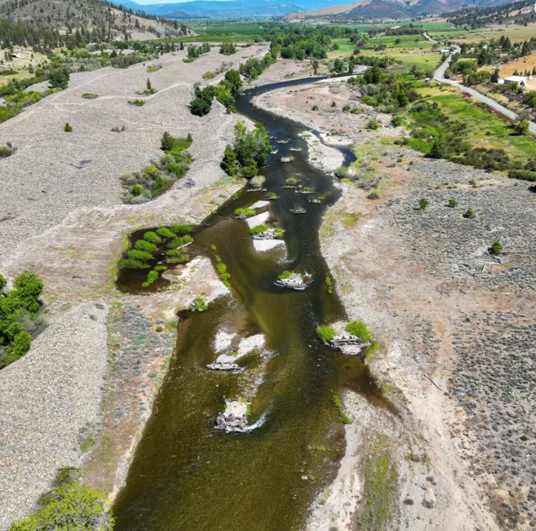
Physical Processes: Data Gaps and Needs
Repeat LiDAR
Long term support for SVIHM (and/or Water Board Model)

Slide 81
Shasta, Scott and Salmon Rivers
Lyra Cressey
Notes:
IFRMP Plan maps and icon

Slide 82
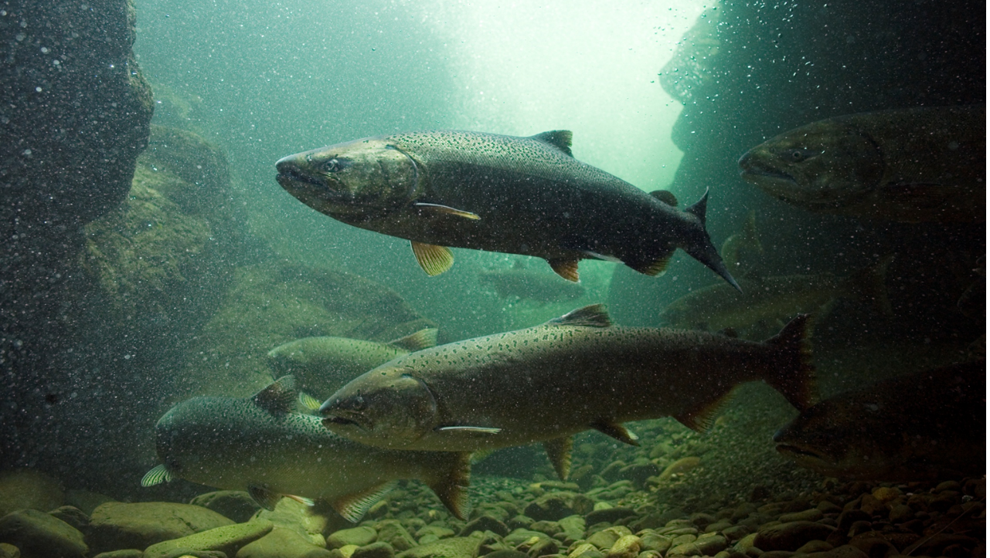
Lyra Cressey
Salmon River Restoration Council
Salmon River Monitoring
lyra@srrc.org

Slide 83
Adult Fisheries Monitoring
MONITORING EFFORT | ENTITY/ENTITIES | LOCATION | SPECIES | PURPOSE | WORK PRODUCTS/INFO STORAGE | FUNDING
Spring Chinook and Summer Steelhead Population Dive | SRRC/USFS/Karuk Tribe/volunteers | Salmon River - mouth to top of anadromy + Wooley Creek and other large tribs | Spring Chinook and Summer Steelhead | Adult population trends | Long term data trends; USFS Salmon/Scott annual Chinook reports | Federal - Karuk Tribe, USFS, various
Spring Chinook Carcass and Redd Surveys | SRRC/CDFW/USFS/ Karuk Tribe | North Fork and South Fork Salmon + Wooley Creek and other large tribs, upper mainstem occassionally | Spring Chinook | Adult population | Long term data trends; USFS Salmon/Scott annual Chinook reports | Federal - Karuk Tribe, various
Fall Chinook Carcass and Redd Surveys | CDFW/SRRC/USFS/ Karuk Tribe | Mainstem, lower NF and SF Salmon | Fall Chinook | Adult population | Fishing regulations; Fall Chinook Mega Table | Federal - USFWS

Slide 84
Juvenile Fisheries Monitoring
MONITORING EFFORT | ENTITY/ENTITIES | LOCATION | SPECIES | PURPOSE | WORK PRODUCTS/INFO STORAGE | FUNDING
Juvenile Outmigrant Trap | Karuk Tribe/SRRC/Amy Fingerle – UC Berkeley | Lower mainstem, North Fork and South Fork Samon | Chinook, Coho, O.mykiss (sthd/resid), Lamprey | Genetics and allele distribution and abundance of spring and fall Chinook | PHD; Online mapping tool | Karuk Tribe/Wild Salmon Center
Juvenile Grab Sampling and Habitat Use | Karuk Tribe/SRRC/Amy Fingerle – UC Berkeley | Throughout watershed within bounds of anadromy | Chinook | Genetics, allele distribution & abundance of spring & fall Chinook, juvenile habitat usage by age | PHD; Online mapping tool | Karuk Tribe/Wild Salmon Center
Juvenile snorkel surveys | SRRC | Throughout watershed in association with tributary fish passage and habitat restoration projects | Chinook, Coho, O.mykiss (sthd/resid) | Assessing habitat conditions and fish usage | Post Implementation Monitoring for Restoration Sites; Creek mouth enhancement | CDFW FRGP and RGP, Karuk Tribe
Lamprey Assessment | SRRC, Karuk Tribe, USFS | Throughout watershed | Pacific lamprey and potentially other species? | Assessing habitat and establishing distribution and abundance | Distribution map; mapping tool; report | Federal – PLCI/USFWS

Slide 85
Water Monitoring
MONITORING EFFORT | ENTITY/ENTITIES | LOCATION | SPECIES | PURPOSE | WORK PRODUCTS/INFO STORAGE | FUNDING
Temperature Probes | SRRC/USFS | ~35 locations throughout the watershed |  | Long term monitoring,TMDL Compliance | USFS enters data into NRIS. SRRC keeps the data in an in-house database. | USFS (currently unfunded), Karuk Tribe
Datasonde | Karuk Tribe | Mainstem Salmon above confluence with Klamath |  | Watershed conditions | Online at Karuk website | Karuk Tribe
Discharge | USGS | Mainstem Salmon above confluence with Klamath |  | Long term monitoring | Online at USGS | Federal
 | SRRC | ~ 12 Locations throughout the watershed |  | Long term monitoring | SRRC spreadsheet | SRRC - unfunded

Slide 86
Physical Monitoring
MONITORING EFFORT | ENTITY/ENTITIES | LOCATION | SPECIES | PURPOSE | WORK PRODUCTS/INFO STORAGE | FUNDING
Restoration | SRRC | Restoration sites on North Fork and South Fork Salmon - Kelly Bar, Red Bank, Winder, Hotelling, Matthews |  | Restoration effectiveness | Restoration project monitoring reports | CDFW
Habitat Typing/ Sediment monitoring | USFS | Tributaries |  | Watershed condition |  | USFS

Slide 87
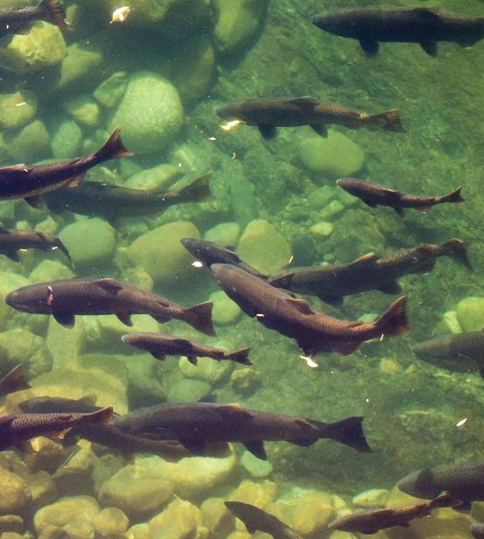
Other Questions…
Is the funding secure?
Almost entirely federally funded, so NO
Are there key challenges, such as logistics?
Remote watershed, difficult for partners to travel to, lack of federal spring Chinook listing to mandate support or recovery objectives
Are there important gaps that should be addressed?
Lamprey, steelhead population…others?
Are there alternative approaches to collecting the data that could be considered?
Photo: Janjaap Dekker

Slide 88
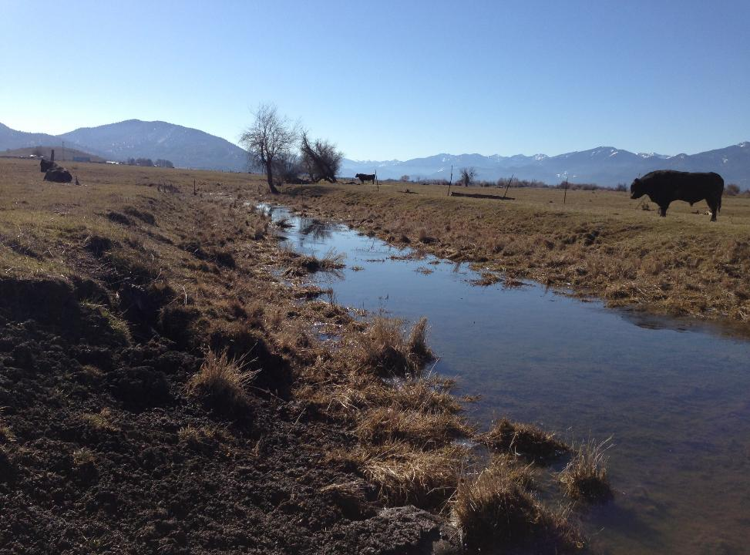
Back AT 1:15
LUNCH
Livestock grazing in riparian zone, Upper Klamath Basin, OR (USFWS 2013)
Notes:
Livestock grazing in riparian zone, Upper Klamath Basin, OR (USFWS 2013)

Slide 89
Lunch Options
1–5-minute walk from Ashland Springs Hotel
In Hotel – Larks Home Kitchen
Zoey’s Café (across the street) – 199 E. Main St, Ashland, OR
Louis’s (Gluten-Free, Vegetarian friendly) – 41 N. Main St, Ashland, OR
Brothers’ Restaurant (open until 1:30 pm) – 95 N. Main St, Ashland, OR
Thai Pepper – 84 N. Main St, Ashland, OR
Bird and Rye – 23 S. 2nd St, Ashland, OR

Slide 90
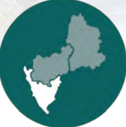
Lower Klamath Basin
Notes:
IFRMP Plan maps and icon

Slide 91
Lower Klamath Basin
Mike Belchik
Notes:
IFRMP Plan maps and icon

Slide 92
Klamath River Program
Weitchpec, CA

Slide 93
Klamath River Program Primary Objectives
Research, Monitoring and Management of Klamath River Fish Disease Issues
To Monitor Juvenile and Adult salmonid populations
To Research and Monitor non-Salmonid Species like Green Sturgeon and Lamprey

Slide 94
Klamath River Program 2025 Projects
Juvenile outmigrant Screw Trapping at Weitchpec
Eulachon (Candlefish) Environmental DNA Monitoring in the Klamath River
Thermal Refugia Monitoring of Reservation Creek Mouths
Green Sturgeon Acoustic Tag Monitoring
Macroinvertebrate Surveys
Adult Salmonid Disease Monitoring

Slide 95
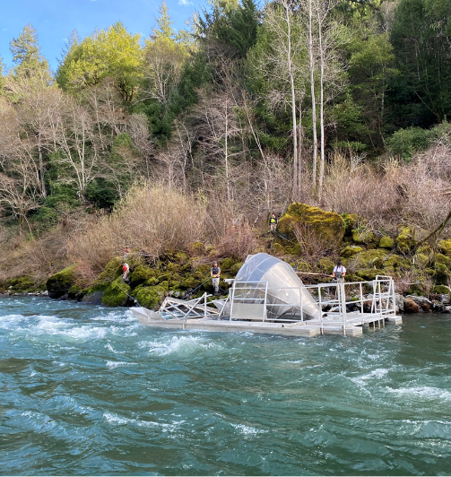
Juvenile Outmigrant rotary screw trap
Rotary screw trap deployed annually March-July (flow dependent)
Assess timing, abundance and condition of outmigrating juvenile salmonids
Project carried out in partnership with USFWS arcata office, annual report available on their website
*funded by bor afa

Slide 96
Eulachon eDNA Monitoring
Take water samples to assist monitoring of spatial & temporal distribution of southern dps eulachon in mainstem Klamath river & redwood creek
Logistical challenges include site access/sampling safety during high flow events & variance in run timing/detection
*Merkley funding

Slide 97
Thermal refugia
Monitor thermal refuge use for both juvenile and adult salmonids during summer months
Help assess fish condition during periods of elevated water temp in mainstem
Inform management decisions regarding fish health, mortality & flow augmentation
*funded by bor afa

Slide 98
Green sturgeon monitoring
2002-present
Monitor presence & run timing of acoustic tagged adult green sturgeon
Inform managers on run timing, survival & straying of tagged adult green sturgeon
*Merkley fuNding

Slide 99
aquatic invertebrate dam removal monitoring
Before & after comparison of invertebrate abundance and diversity
Quarterly sampling at 10 sites along Klamath River
Blue Creek
Weitchpec
I-5
Irongate
Copco Bridge (new)
Jennny & Beaver Creek (new)
Help inform managers on ecosystem health and food availability for salmon
*Funded by PCSRF

Slide 100
Adult Salmonid Disease Monitoring
Crew captures adult salmon as they are migrating upstream
All fish are given a thorough examination to check for disease (Primarily Ich & Columnaris)
Fish condition is documented and any disease levels are recorded
This data is used to inform water managers of conditions on the river and augment river flows if necessary
*Funded by BOR AFA

Slide 101
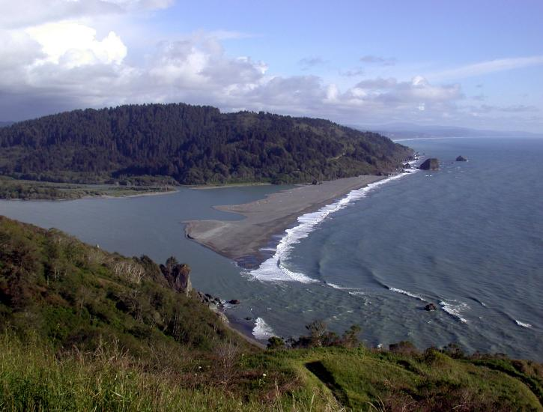
Other Lower Klamath Monitoring

Slide 102
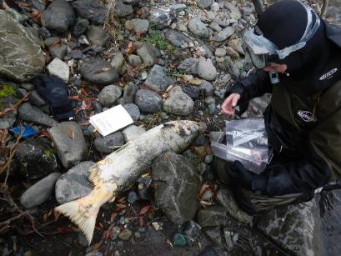
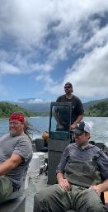
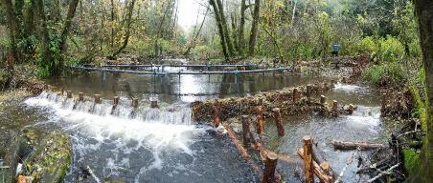
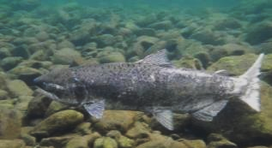
Lower Klamath River – Coho Surveys
McGarvey Creek Beaver Dam Analogue Site & PIT Tag Antennas
Blue Creek Spawner Surveys
Blue Creek Outmigrant Trap
YTFD-LKP & Fiori GeoSciences – Restoration Team
McGarvey Creek Outmigrant Trap

Slide 103
McGarvey Non-Natal Coho Detections
McGarvey
Creek

Slide 104
Wok-hlew’
Photo by Ben Laukka
McGarvey Creek Coho

Slide 105
Trinity and South Fork Trinity Rivers
Notes:
IFRMP Plan maps and icon

Slide 106
Group Discussion Regarding Existing Activity
Notes:
BRUCE sets up group discussion and mentions handouts

Slide 107
Handouts and Questions for Discussions
Handouts (resources)
Discussion Questions
IFRMP goals, objectives and indicators
Gaps in existing monitoring and new monitoring needed
Extracted content from 2023 IFRMP Plan
Summary of May 5-13, 2025, survey
Are there opportunities for efficiencies?
Are there alternative techniques or approaches we should be considering?
Are there important gaps not covered by the existing programs?
Are there frameworks we should consider to identify new work and set priorities for funding?

Slide 108
Plans for Day 2
Notes:
BRUCE

Slide 109
Day 2 – May 15
Half Day (9am start, Adjourn at 12pm)
Reflections on Day 1
Priorities Exercise
Monitoring Plan Formulation
Closing Remarks
Steering Committee Meeting – 1:00 – 2:30 (over lunch)

Slide 110
Timeline Process, Outcomes and Products
Initiation
Jan-Apr 2025
1st Workshop
May 14-15, 2025
Tech SC Tasks
May 15 – June 20
2nd Workshop
June 24-25, 2025
Convene planning committee
Identify presenters for needed topics
Initiate gap discussion and prioritization
Approach for 5-yr monitoring strategy
Form Technical Steering Committee
List shared management and research questions
Criteria to prioritize/sequence for next 5 yrs funding scenarios
Refine shared list questions
Refine criteria
Confirm approach to develop 2026-2027 list of priority monitoring
List of Priority Monitoring for 2026-2027 Funding
July-Sept 2025
Federal Fiscal Year Recommendations
Oct 1, 2025 (tentative)
Tech SC Tasks
Sept 2025 Oct 2026
Klamath Basin Collaborative 5yr Plan
Oct 2026
Provide content for strategy
Consider most informative timing for a Science Symposium
PSMFC assist with compilation and product development
Finalized list of Klamath Basin monitoring (existing/new) to prioritize for 2026-2027 funding
Submit agreed-to recommended prioritized monitoring list to funding agencies
Produce 5-yr Plan
Approach to continue this collaborative forum 2025-2030 to implement and revise 5-yr Plan
Notes:
BRUCE
Lost River and Tule Lake (USFWS 2011)

Slide 111
Adjourn
Reconvene tomorrow at 9:00
A landscape featuring a river and forested hills. Photo courtesy of NOAA. (USFWS)
Notes:
A landscape featuring a river and forested hills. Photo courtesy of NOAA. (USFWS)

