Slide 1
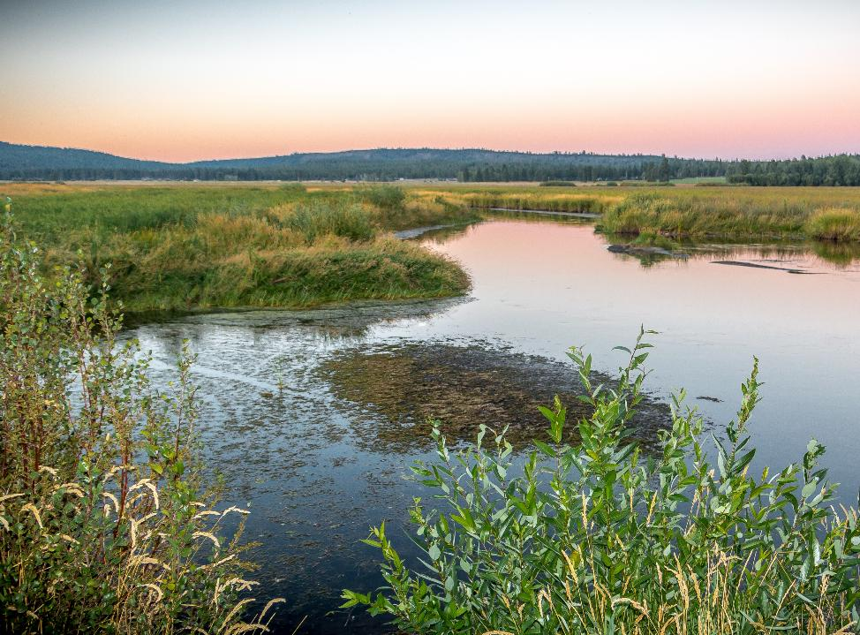
Klamath Basin Collaborative Monitoring Plan Workshop Day 2 – Welcome Back
May 14 -15, 2025
Ashland Springs Hotel
Ashland Oregon
Wood River Wetland-, Klamath County Oregon (USFWS 2016)
Notes:
BRUCE
Wood River Wetland-, Klamath County Oregon (USFWS 2016)

Slide 2
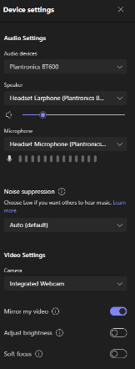
Virtual participants: Please leave web cameras on to facilitate discussion Please use the chat to introduce yourself (name and affiliation) In-person participants: Please sign in on sheet Please grab a name tag
Use the meeting chat if you need assistance.
Chats can be seen by all participants.
Please mute yourself when not speaking.
Use *6 to mute phone audio.
Use the microphone icon on the control bar to mute computer audio.
If you are having problems with audio/video, check your device settings.
Notes:
BRUCE
Betsy :
Restrooms etc
Map UP- ask for input!
Owl is sound sensitive,
Recording for note taking purposes.
Powerpoint slides available after meeting,
Virtual participation encouragement, MAP virtual option (link in CHAT), Use CHAT for input or RAISE HAND to speak
Show of hands for dinner adjust reservation
Lunches will arrive by noon
Microsoft Teams meeting for Day 1 and Day 2
Join on your computer, mobile app or room device
Click here to join the meeting
Meeting ID: 244 372 893 378 Passcode: SN2K5a
Download Teams | Join on the web
Or call in (audio only)
+1 207-387-0436,,843358102# United States, Portland
Phone Conference ID: 843 358 102#

Slide 3
Welcome and Agenda
Notes:
BRUCE

Slide 4
Agenda
Welcome and Agenda | 9:00 – 9:15
Reflections on Day 1 | 9:15 – 9:45
Priorities Exercise and Data Sharing | 9:45 – 10:15
Break | 10:15 –10:30
Discuss Exercise Results | 1:15 – 2:00
Monitoring Plan Formulation - Schedule and Steering Committee formation - Discuss development of 5-year monitoring strategy and whether IFRMP Framework can be leveraged - Approach to support ongoing coordination over next 5-yrs - Second workshop (June 24-25) | 11:00 – 11:45
Closing Remarks | 11:45 – 12:00
Adjourn | 12:00
Technical Steering Committee Meeting – over lunch | 12:00 – 12:30
Notes:
BRUCE

Slide 5
Reflections on Day 1
Notes:
BRUCE

Slide 6
Timeline Process, Outcomes and Products
Initiation
Jan-Apr 2025
1st Workshop
May 14-15, 2025
Tech SC Tasks
May 15 – June 20
2nd Workshop
June 24-25, 2025
Convene planning committee
Identify presenters for needed topics
Initiate gap discussion and prioritization
Approach for 5-yr monitoring strategy
Form Technical Steering Committee
List shared management and research questions
Criteria to prioritize/sequence for next 5 yrs funding scenarios
Refine shared list questions
Refine criteria
Confirm approach to develop 2026-2027 list of priority monitoring
List of Priority Monitoring for 2026-2027 Funding
July-Sept 2025
Federal Fiscal Year Recommendations
Oct 1, 2025 (tentative)
Tech SC Tasks
Sept 2025 Oct 2026
Klamath Basin Collaborative 5yr Plan
Oct 2026
Provide content for strategy
Consider most informative timing for a Science Symposium
PSMFC assist with compilation and product development
Finalized list of Klamath Basin monitoring (existing/new) to prioritize for 2026-2027 funding
Submit agreed-to recommended prioritized monitoring list to funding agencies
Produce 5-yr Plan
Approach to continue this collaborative forum 2025-2030 to implement and revise 5-yr Plan
Notes:
BRUCE
Lost River and Tule Lake (USFWS 2011)

Slide 7
Priorities Exercise and Data Sharing
Notes:
BRUCE

Slide 8
Instructions
Everyone has 10 stars (Dollars $$) to spend
Individually allocate your stars to the categories you consider to be the highest priorities
Notes:
BRUCE

Slide 9
Priorities Exercise
https://forms.cloud.microsoft/r/DhD6fSwJbN

Slide 10
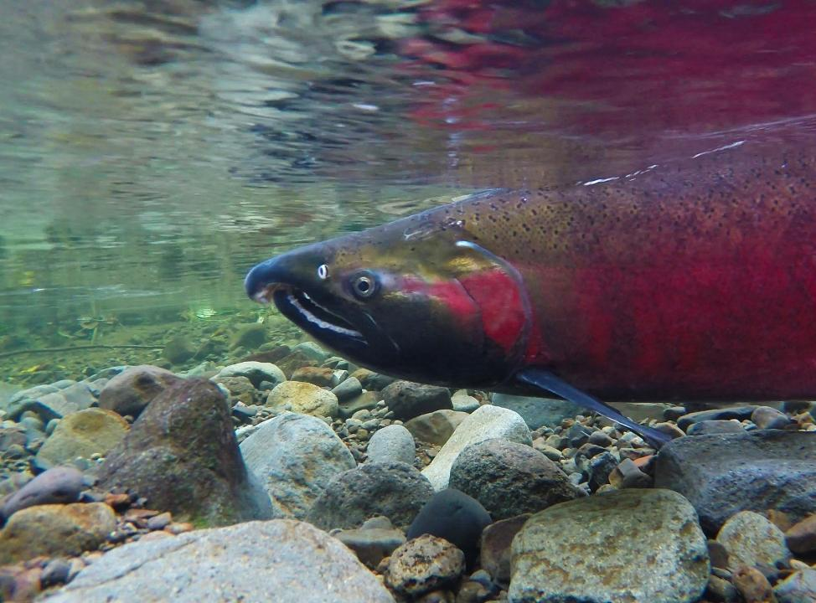
Back in 15 minutes
Coho salmon spawning in the Salmon River (USFWS 2015)
Break
Notes:
BRUCE
Coho salmon spawning in the Salmon River (USFWS 2015)

Slide 11
Discuss Exercise Results
Notes:
BRUCE

Slide 12
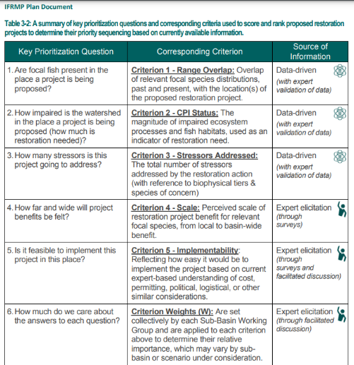
IFRMP habitat restoration criteria
Potential monitoring criteria
What fish species are we most concerned about monitoring their status and trend?
Which factors are limiting / impacting the target fish species that we need to monitor?
What monitoring approach would inform broad scale assessments or inform population/stock level assessments?
Are these data informing shared management questions or critical uncertainties?
Notes:
May 14-15, 2025 Workshop's Potential monitoring criteria (1) What fish species are we most concerned about monitoring their status and trend? (2) Which factors are limiting / impacting the target fish species that we need to monitor? (3) What monitoring approach would inform broad scale assessments or inform population/stock level assessments? (4) Are these data informing shared management questions or critical uncertainties?

Slide 13
Monitoring Plan Formulation
- Schedule and Steering Committee formation
- Discuss development of 5-year monitoring strategy and whether IFRMP Framework can be leveraged
Approach to support ongoing coordination over next 5-yrs
Second workshop (June 24-25)
Notes:
BRUCE

Slide 14
Plan Formulation
Schedule
Steering Committee formation
Development of 5-year monitoring strategy
Can we leverage the IFRMP Framework?
Approach to support ongoing coordination over next 5-yrs
Second workshop (June 24-25)

Slide 15
Timeline Process, Outcomes and Products
Initiation
Jan-Apr 2025
1st Workshop
May 14-15, 2025
Tech SC Tasks
May 15 – June 20
2nd Workshop
June 24-25, 2025
Convene planning committee
Identify presenters for needed topics
Initiate gap discussion and prioritization
Approach for 5-yr monitoring strategy
Form Technical Steering Committee
List shared management and research questions
Criteria to prioritize/sequence for next 5 yrs funding scenarios
Refine shared list questions
Refine criteria
Confirm approach to develop 2026-2027 list of priority monitoring
List of Priority Monitoring for 2026-2027 Funding
July-Sept 2025
Federal Fiscal Year Recommendations
Oct 1, 2025 (tentative)
Tech SC Tasks
Sept 2025 Oct 2026
Klamath Basin Collaborative 5yr Plan
Oct 2026
Provide content for strategy
Consider most informative timing for a Science Symposium
PSMFC assist with compilation and product development
Finalized list of Klamath Basin monitoring (existing/new) to prioritize for 2026-2027 funding
Submit agreed-to recommended prioritized monitoring list to funding agencies
Produce 5-yr Plan
Approach to continue this collaborative forum 2025-2030 to implement and revise 5-yr Plan
Notes:
BRUCE
Lost River and Tule Lake (USFWS 2011)

Slide 16
Technical Steering Committee
Providing information on specific monitoring activities
Contacts, expert knowledge, publications, funding, etc
Reviewing draft materials
Material for June workshop
Draft list of priorities to recommend for fiscal year 2026 +
Assist with collaborative monitoring plan
Drafted by a technical consultant

Slide 17
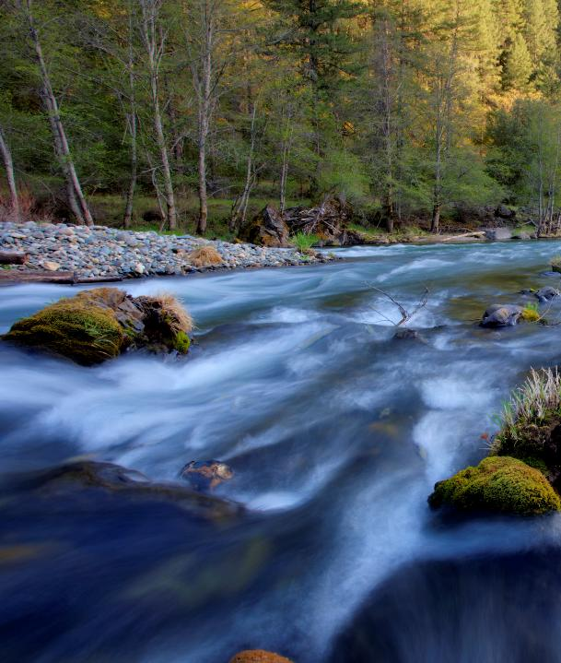
Closing Remarks
Trinity River flowing in Northern California (USFWS 2009)
Notes:
BRUCE
Trinity River flowing in Northern California (USFWS 2009)

Slide 18
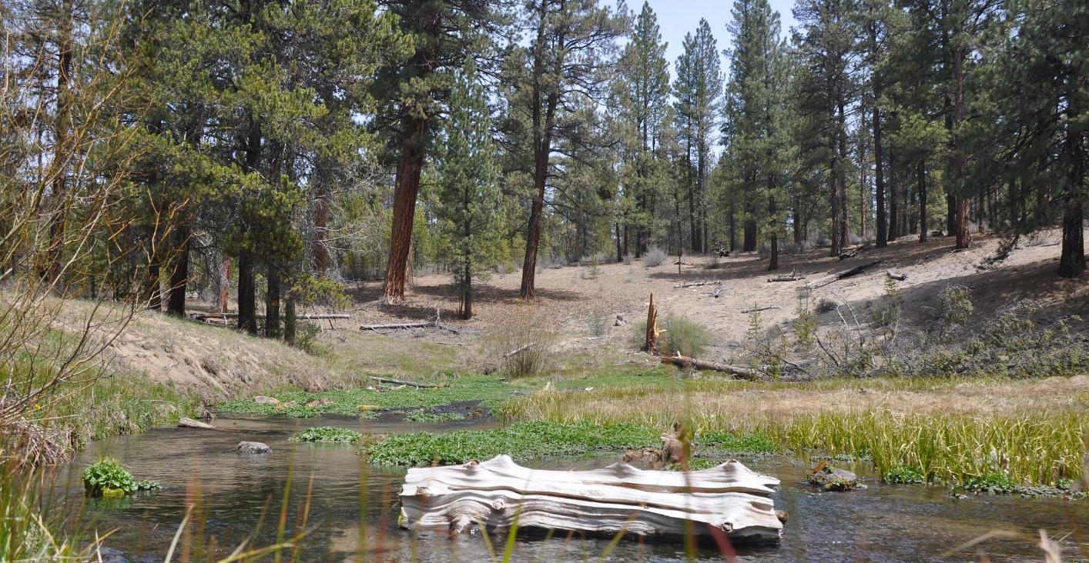
Adjourn
Technical Steering Committee Meeting
– reconvene at 12:00 – 12:30
Williamson River headwaters in Oregon (USFWS 2011)
Notes:
BRUCE: get your lunch and reconvene at 1pm
Williamson River headwaters in Oregon (USFWS 2011)

Slide 19
Lunch Options
1–5-minute walk from Ashland Springs Hotel
In Hotel – Larks Home Kitchen
Zoey’s Café (across the street) – 199 E. Main St, Ashland, OR
Louis’s (Gluten-Free, Vegetarian friendly) – 41 N. Main St, Ashland, OR
Brothers’ Restaurant (open until 1:30 pm) – 95 N. Main St, Ashland, OR
Thai Pepper – 84 N. Main St, Ashland, OR
Bird and Rye – 23 S. 2nd St, Ashland, OR

